Slide 1
Jönköping University
School of Health and Welfare
Institute of gerontology (IFG)

Slide 2
Jönköping University
The educational institution is organized in the form of a foundation with six wholly owned subsidiaries
School of Health and Welfare
School of Education and Communication
School of Engineering
Jönköping International Business School
Jönköping University Enterprise
University Services

Slide 3
The parts make the whole
800+
1 100
million SEK
Employees
Turnover
14 700+
2 000
Students
International students
1 000+
320
Partner companies
Partner universities worldwide

Slide 4
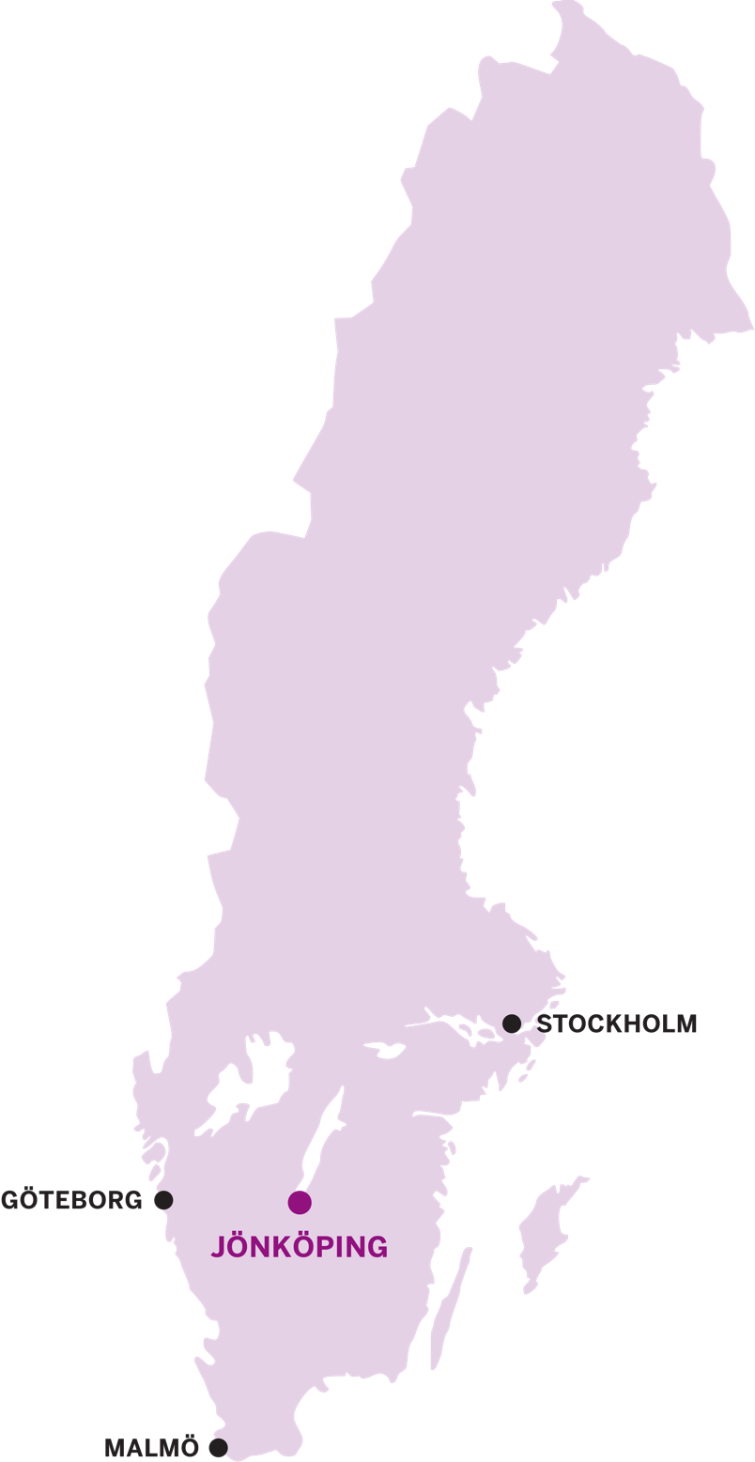
Jönköping
Fantastic location surrounded by three beautiful lakes.
Tenth largest city in Sweden.
Good communication links between
Jönköping and other metropolitan areas.
Vätterstranden – a 2km long beach in the
city centre.
Wide range of leisure and sports facilities and plenty of opportunities for outdoor activities
A cultural hub: theatres, museums, cinemas and concert halls.

Slide 5
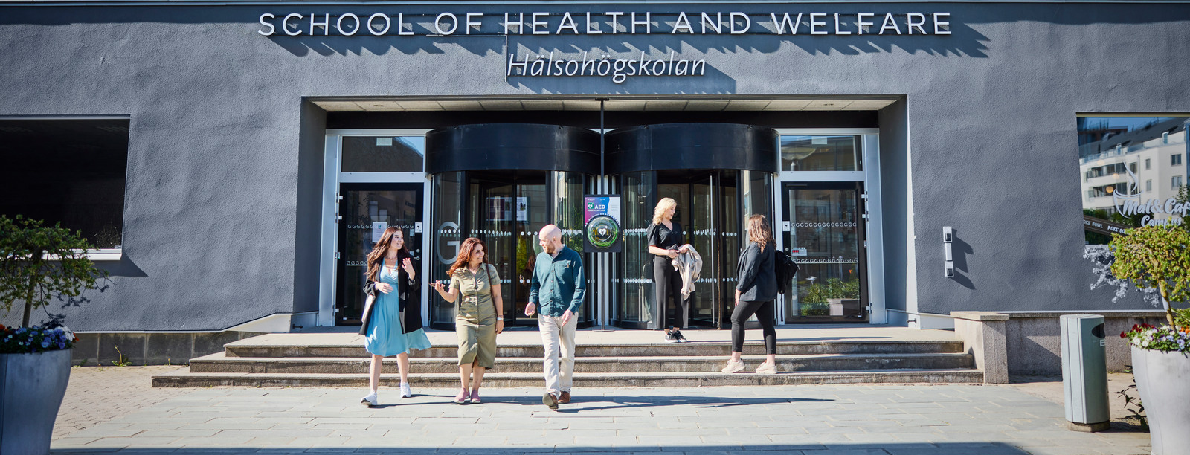
I Welcome I Välkommen I Bienvenue I Tervetuloa I Καλώς ήρθατε I I Vitajte I Vítejte I Bienvenido I Willkommen I Benvenuti I
Hälsohögskolan

Slide 6

School of Health and Welfare 2025​

Slide 7
VI ÄR
WE ARE
HÄLSOHÖGSKOLAN
THE SCHOOL OF HEALTH AND WELFARE
Kreativitet i varje tanke
Innovera, fantisera och utmana det invanda.
Samarbete i varje steg
Lär tillsammans, väx tillsammans, påverka tillsammans.
Hållbarhet i varje beslut
Bygg en framtid som bryr sig; om människor och om planeten.
Creativity in every thought
Innovate, imagine and challenge the established.
Collaboration in every step
Learn together, grow together, influence together .
Sustainability in every decision
Build a future that cares; about people and about the planet

Slide 8
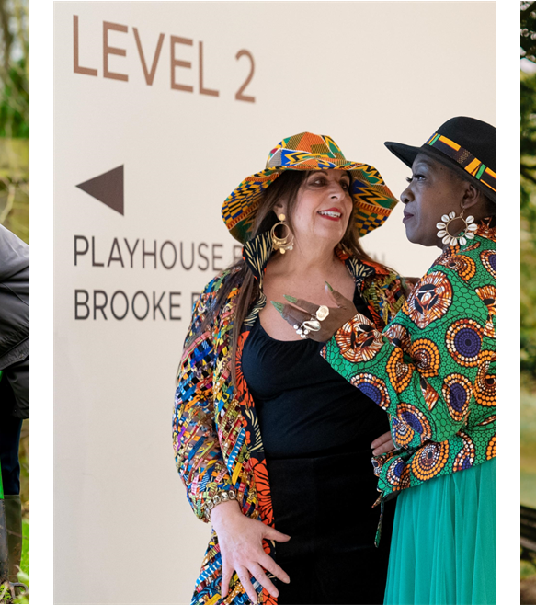
Ageing and Society - Nordic perspectives
10 credits
Web-based
Approx. 50% (20 hours/week)
Spring 2027

Slide 9

Content
Drawing on social gerontology, this course aims to provide a critical understanding of (old) age and how it can be understood as socially and culturally constructed. It will examine the position of older people in society and how age intersects with gender, ethnicity, socioeconomic position, and functional ability.
Age as a social construct
Cultural representations of age, gender, and ethnicity
Ageist attitudes in societies
Older people’s rights, agency, and participation in society
Challenges and possibilities for healthy ageing in different Nordic countries
Part 1: Age and social identity
Part 2: Sustainable ageing societies - Agenda 2030 and issues related to older people
Part 3: Healthy ageing in the Nordic Region - possibilities and challenges.

Slide 10
Intended Learning Outcomes
Knowledge and understanding
Identify and analyse the social dimensions of age and their relation to other dimensions of identity, such as gender, ethnicity, and functionality
Analyse how age as a social position can intersect with other positions to create inequalities in health and welfare
Skills and abilities
Discuss different approaches to support the participation and inclusion of older people
Use social dimensions of age, as well as gender, ethnicity, and functionality as an analytical lens to investigate the situation of older people in society
Apply an interdisciplinary perspective and an intersectional approach in relation to age and ageing
Critically compare and reflect on challenges and possibilities for healthy ageing in Nordic countries
Judgement and approach
Reflect on how attitudes towards ageing and older people in societies, social policies, and by healthcare workers can have an impact on older people’s lives
Reflect on older people’s rights, agency and autonomy

Slide 11
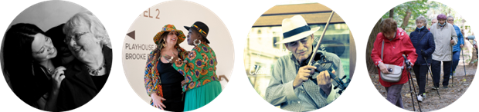
Examination and grades
The course is graded Pass with distinction, Pass or Fail.
The final grade will be based on active participation in group discussions and individual written assignments
Discussions (1.5 credits)
Written assignment 1 (6 credits) – Part 1 & 2.
Written assignment 2 (2.5 credits) – Part 3.

Slide 12
Part 1. Age and social identity
In Age and identity (Part 1), we tackle how age is understood as something socially and culturally constructed. We discuss how "old age" is constructed as a social category. Intersectionality is also introduced, and examples from research are discussed, where age intersects with ethnicity and gender.
Lectures, inspirational videos, and reading material
Examination: Group discussion

Slide 13
Part 2. Sustainable ageing societies
Agenda 2030 and issues related to older people. Here, the student will work both independently on finding a scientific article, and as a group to discuss the Agenda 2030 goals and to share the article they have found
Lectures, inspirational videos, and reading material
Examination: Group discussion
Examination written assignment 1: Formulate a topic or question to write on where age and old age intersect with other social positions, e.g., ethnicity, social class, gender, sexual orientation, disability/functionality.
Notes:
Analyse how age intersects and why it is relevant. E.g. what does the intersection of these social positions mean for the services and care of older people in that group? Are there dilemmas involved, and for whom? Are there different contrasting perspectives, or cases of double discrimination? Motivate your topic in relation to societal relevance.

Slide 14
Part 3. Healthy ageing in the Nordic Region – possibilities and challenges
ILO: Critically compare and reflect on challenges and possibilities for healthy ageing in Nordic countries
Under development
Example of literature that could be useful
Cuadrado, A., Stjernberg, M., & Huynh, D. (2022). Indicators for Active and Healthy Ageing in the Nordic Region: Possibilities and Challenges.
Dahlberg, L., McKee, K. J., Lennartsson, C., & Rehnberg, J. (2022). A social exclusion perspective on loneliness in older adults in the Nordic countries. European Journal of Ageing, 19(2), 175-188.
Kjelvik, G. (2024). Dementia prevention in the Nordics.

Slide 15
After finishing this course:
you will be able to identify and analyse the social dimensions of age and their relation to other dimensions of identity such as gender, ethnicity and functionality.
You will be able to use knowledge gained in this course as an analytical lens to investigate the situation of older people and society.
You will also deepen your understanding of different approaches that support the participation and inclusion of older people in society, in areas such as old age care.

Slide 16
Application timeline
Students in Sweden apply to our Master’s program in gerontology (120hp)
March 16 – April 15
Distance learning. Four years on 50%
30 credits NordMaG courses as a minimum, including the course Ageing and Society – Nordic Perspectives
If only online: the courses in Iceland and Finland.
But also possible to do exchange studies in Norway and Denmark through Erasmus.Read more about possible exchange studies via NordMaG and Jönköping University: https://ju.se/student/en/exchange/exchange-opportunities-and-requirements/hhj.html#showmore-ExchangeStudies

Slide 17
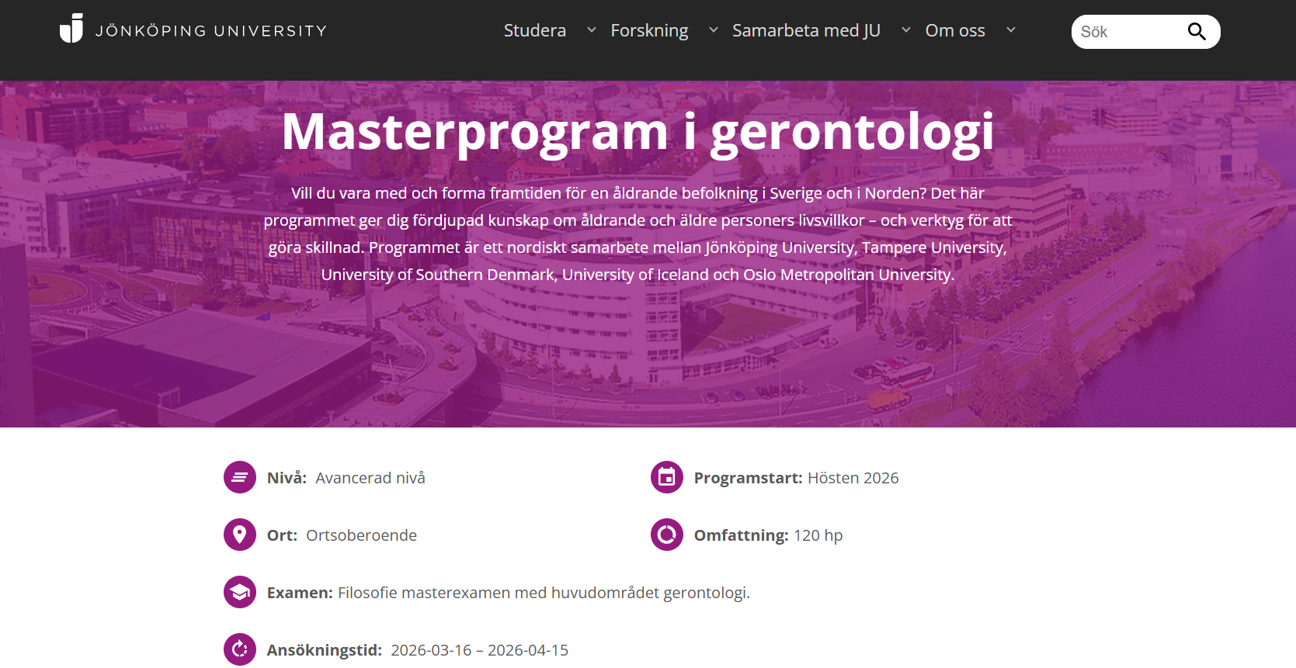
Application timeline
Students in Sweden apply to our Master’s program in gerontology (120hp)
Distance learning. Four years on 50%
https://ju.se/studera/valj-utbildning/program/program-pa-avancerad-niva/masterprogram-i-gerontologi-ht2026-ms115.html

Slide 18

Data for master thesis: NEAR
National E-infrastructure for Aging Research https://www.near-aging.se
17 population-based longitudinal studies on aging and health in Sweden (some are twin studies)
Over 90,000 participants: Baseline ages = 35 to 105 (mean = 73), follow-up of 12 to 52 years.
Measures: clinical, biomedical, psychological, social, economic, and care-related aspects of health and aging.
Application procedure
Completed application form, including project title and description.
CV of the main applicant, who must hold an academic position, e.g., Assistant Professor or equivalent.
List of the desired variables for your project. You can explore available variables on Maelstrom.
Ethical approval needed

Slide 19

Data for master thesis: STR
Swedish Twin Registry: web page
Largest twin registry in the world
Contains records of every twin born in Sweden since 1886 (N = 194,000)
Twins with known zygosity = 87,000
Longitudinal and cross-sectional data
Measures: clinical, biomedical, psychological, social, economic
Application procedure
Application (3-5 pages) submitted to the STR by an applicant with a PhD, MD or equivalent.
Expert Committee will review and assess the applications
2026 deadlines: Feb 10, May 12, Sept 1, Dec 1
Ethical approval needed

Slide 20






Data for master thesis: IGEMS
Interplay of Genes and Environment across Multiple Studies
https://dornsife.usc.edu/cesr/igems/
Consortium of 21 twin studies from 5 countries (Australia, Denmark, Finland, Sweden, USA)
145,000 twins aged 18-108 at intake
Focus on data harmonization for analyses of pooled data
Measures: clinical, biomedical, psychological, social, economic
Application Procedure
Contact IGEMS with preliminary project idea
Present abstract of intent (approved by IGEMS executive committee)
Complete data use agreements

Slide 21
NordMaG contact person
Charlotta Nilsen | Ph.D.
Associate Professor in Gerontology
Program Director, Master’s Programme in Gerontology
Institute of Gerontology | School of Health and Welfare
Jönköping University
charlotta.nilsen@ju.se

